Slide 1
State Space Tree
Eng. Abdulrahman ElMadkhoum

Slide 2
State Space Tree
A State Space Tree is a tree representation used to explore all possible states or solutions in problems related to backtracking, branch and bound, and search algorithms. It is commonly used in problems like constraint satisfaction, and pathfinding.

Slide 3
State Space Tree
1- initial state
2- Goal State
3- operators
4-movements
5-stopping condition
6- State Variable

Slide 4
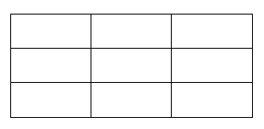
Example X-O Game :
1- initial state
empty 3x3 board
2- Goal state
To have the same symbol at (row or col or diagonal)
3-operators
X – O

Slide 5
Example X-O Game :
4-Movements
Mark empty space
5-Stopping condition
Goal state / no empty spaces left
6-State Variable
2D list [3*3]

Slide 6
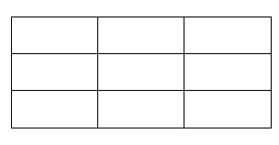
X
X
X
X
X
O
X
O
X
O
X
X
O
X
O
O
We insert the states from left to right

Slide 7
Sheet 1 :
You have a 4 x 4 chess board it is required to put 4 queens on the board such that no queen attacks another. Define the initial and goal states, state variables, operators, and draw the state space tree for the given problem

Slide 8
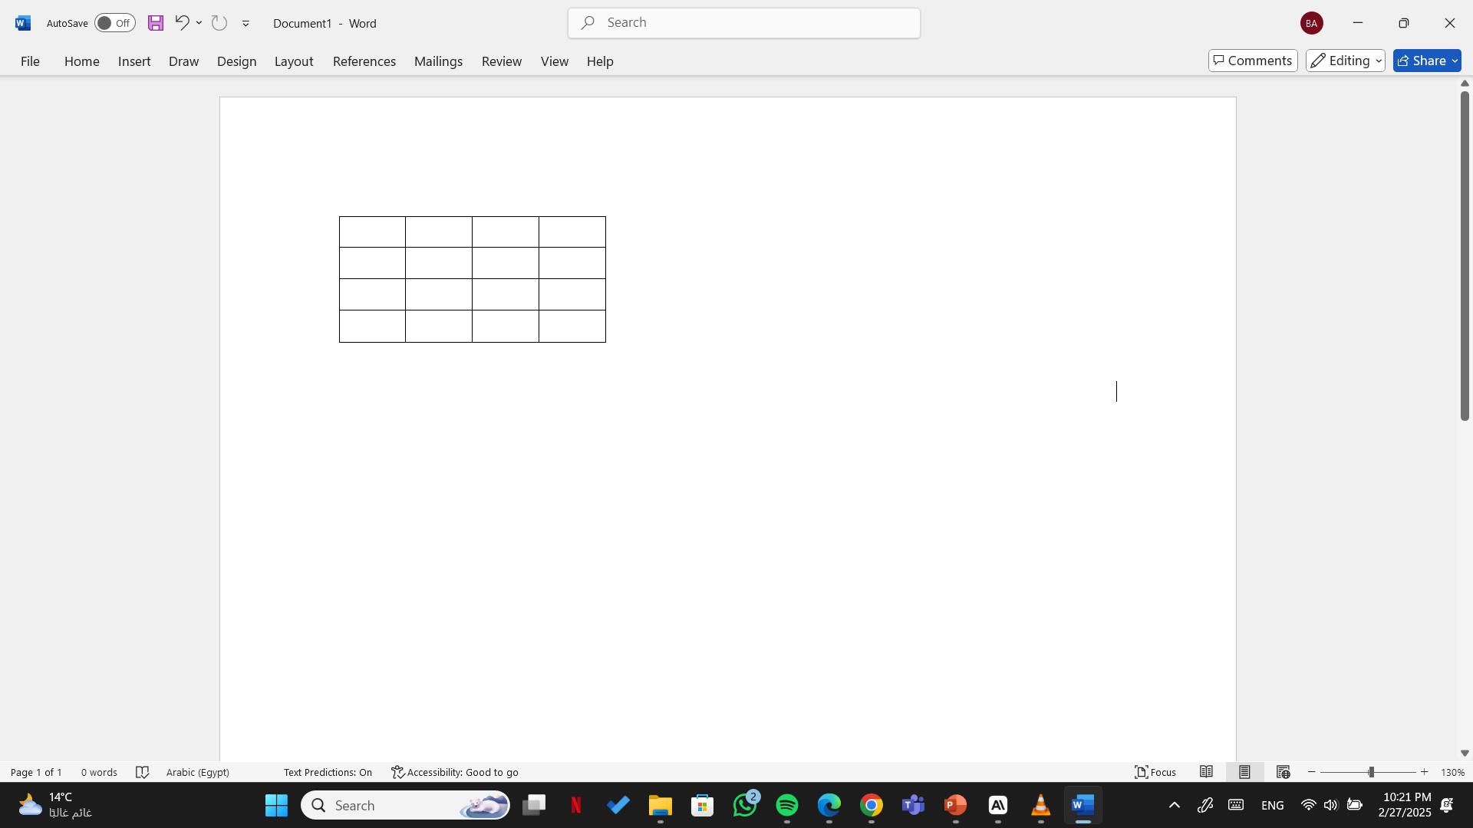
1- initial state
empty 4x4 board
2- Goal state
To put 4 queens on the board such that no queen attacks another
3-operators
4 Queens

Slide 9
4-Movements
Up , down , right , left , right diagonal , left diagonal
5-Stopping condition
Goal state / cannot put the 4th queen
6-State Variable
2D list [4*4]

Slide 10
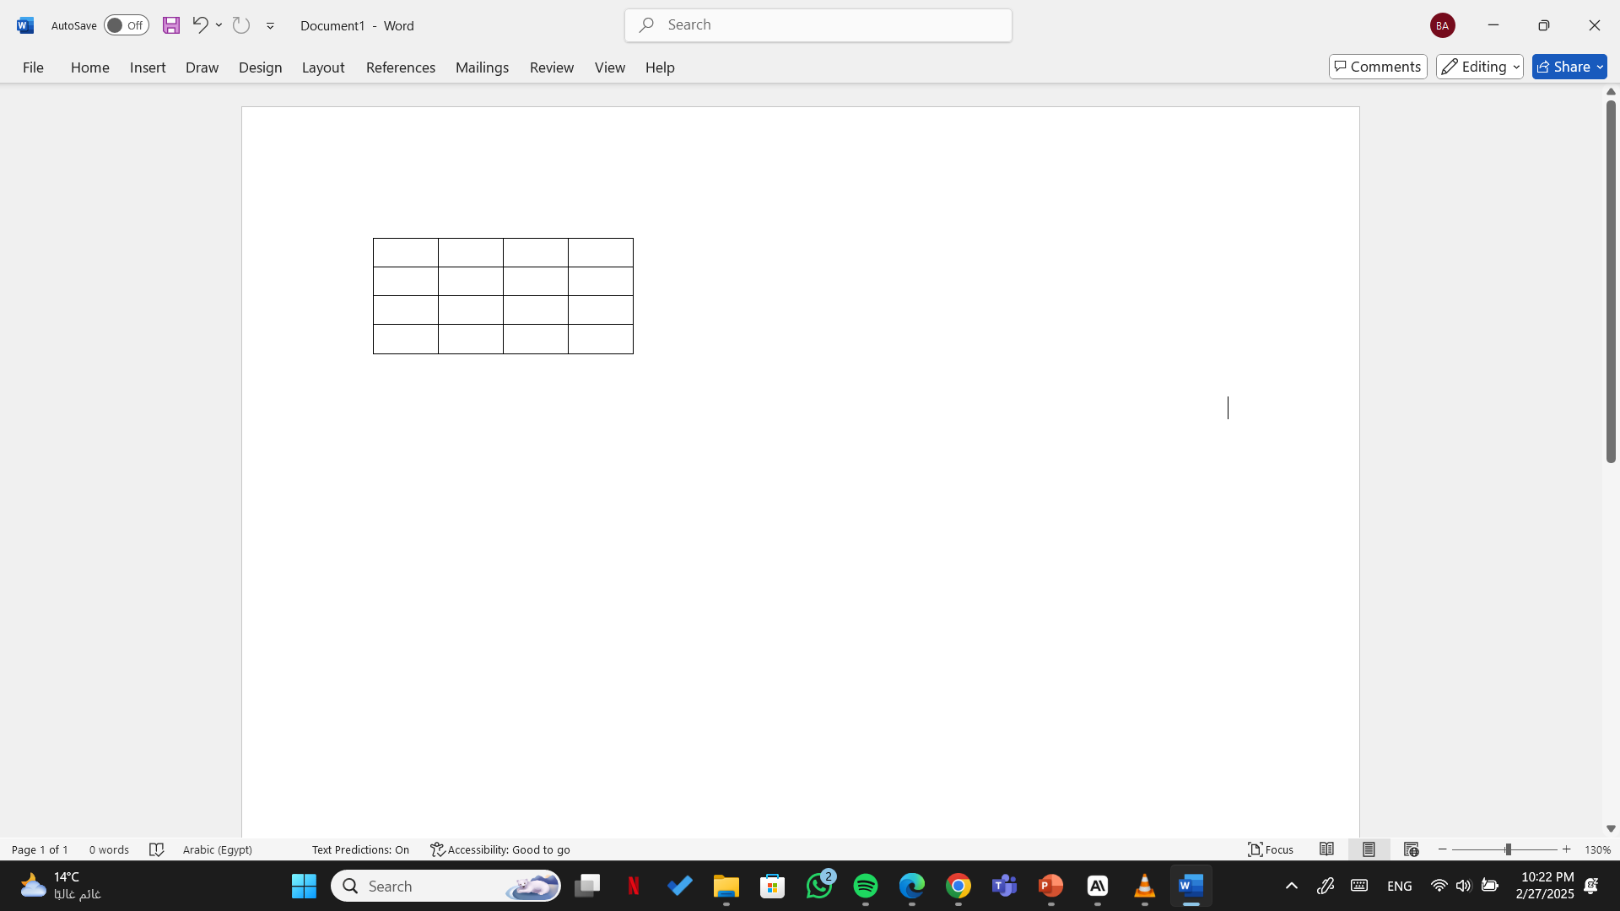
Q
XX
XX
XX
XX
Q
XX
XX
XX
XX
Q
XX
XX
XX
XX
XX
XX
XX
XX
XX
XX
XX
XX
XX
XX
XX
XX
XX
XX
XX
XX
XX
XX
XX
XX
XX
XX
XX
XX
Q
Q
XX
XX
XX
XX
Q
XX
XX
XX
XX
Q
XX
XX
Q
XX
XX
XX
XX
Q
XX
XX
XX
XX
Q
Q
XX
XX
XX
XX
XX
XX
XX
XX
XX
XX
XX
XX
XX
XX
XX
XX
XX
XX
XX
XX
XX
XX
XX
XX
XX
XX
XX
XX
XX
XX
Q
Q
XX
XX
XX
XX
Q
XX
XX
XX
XX
Q
XX
XX
Q
XX
XX
XX
XX
Q
XX
XX
XX
XX
Q
Q
XX
XX
XX
XX
XX
XX
XX
XX
XX
XX
XX
Q
XX
XX
XX
XX
XX
XX
Q
Q
XX
XX
XX
XX
Q
XX
XX
XX
XX
XX
XX
XX
XX
XX
XX
XX
Q
XX
Q
XX
XX
XX
XX
Q
XX
XX
XX
XX
Q
Q
XX
XX
XX
Q
XX
XX
XX
XX
XX
XX
Q
XX
XX
Q
XX
XX
Q
XX
XX

Slide 11
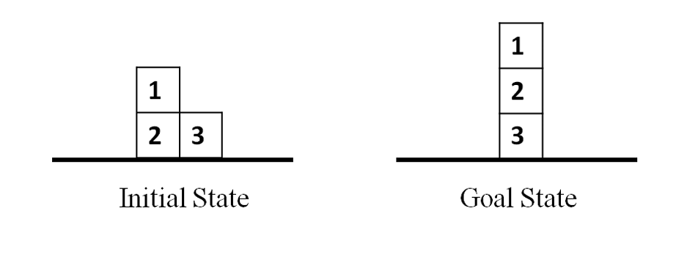
The figure below shows a problem consisting of a table and 3 blocks. The legal operations are to move block X onto block Y if Y is a top block or to move X onto the table. Draw the state space tree for the given problem.

Slide 12
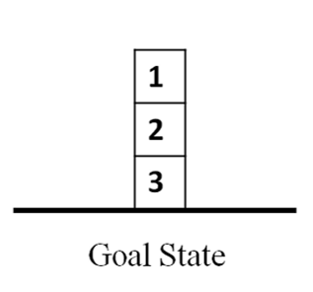
1
operations :
m(1,2)
m(1,3)
m(1,t)
m(2,1)
m(2,3)
m(2,t)
m(3,1)
m(3,2)
m(3,t)
2
3
m(1,3)
m(1,t)
m(3,1)
3
1
1
1
2
3
2
3
2
m(2,1)
m(1,3)
m(2,1)
m(2,3)
m(3,1)
m(3,2)
2
m(1,t)
1
1
2
2
3
3
1
2
3
3
2
3
1
3
1
3
1
2
1
2
m(2,1)
m(2,3)
m(3,2)
m(1,2)
m(2,3)
m(3,2)
m(1,3)
m(3,1)
m(2,1)
m(2,3)
m(3,1)
m(3,2)
2
3
1
m(2,1)
2
1
2
2
3
3
1
2
2
2
2
3
3
3
3
1
3
1
3
1
2
1
2
3
1
3
1
3
1
3
1
1
2
2
1
2
Goal

Slide 13
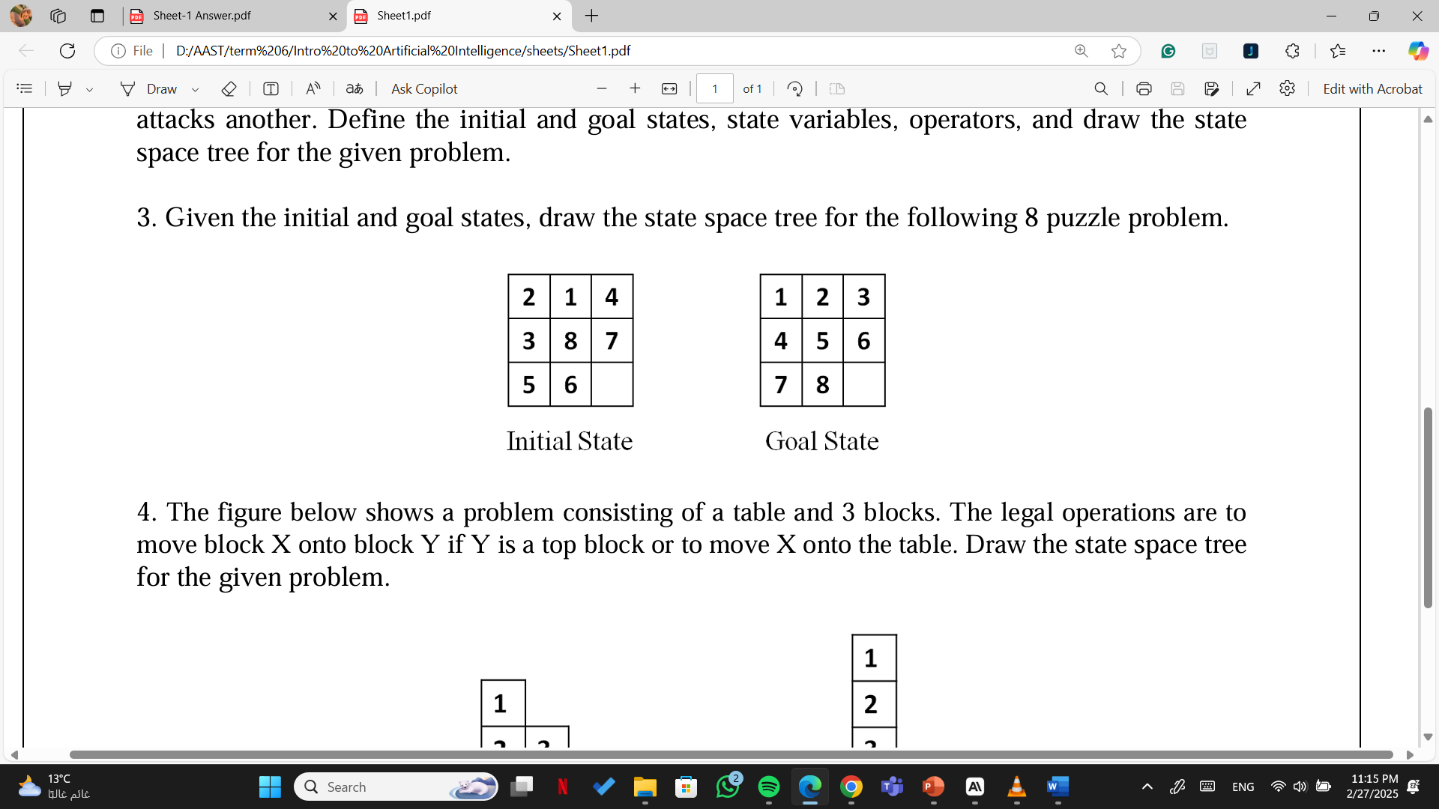
Given the initial and goal states, draw the state space tree for the following 8 puzzle problem.

Slide 14
operations :
mL
mU
mR
mD
2 | 1 | 4
3 | 8 | 7
5 | 6
mL
mU
2 | 1 | 4
3 | 8 | 7
5 |  | 6
2 | 1 | 4
3 | 8
5 | 6 | 7
mL
mU
mL
mU
2 | 1 | 4
3 | 8 | 7
 | 5 | 6
2 | 1 | 4
3 |  | 7
5 | 8 | 6
2 | 1 | 4
3 |  | 8
5 | 6 | 7
2 | 1
3 | 8 | 4
5 | 6 | 7
Allowed moves in order are (left , up , right , down )

Slide 15

You have 3 water jugs whose capacities are 10, 7 and 3 liters respectively. The first jug is full and the other 2 jugs are empty. It is required to put 5 liters in the first and 5 liters in the second. (Note: no additional source of water is available and no tool for measuring). Define the initial and goal states, state variables, operators, and draw the state space tree for the given problem.
operations :
A -> B
A -> C
B -> A
B -> C
C -> A
C -> B
10
5
5
10L
7L
3L
10L
7L
3L
A
B
C
A
B
C
Initial State
Goal State

